Slide 1
Policies and technologies in development of free access to legal information AustLII’s experience, 1992-2012
Graham Greenleaf & Philip Chung
UNSW Faculty of Law & Co-Directors, AustLII
Jurisin Workshop, Miyazaki, Japan November 2012

Slide 2
20 years ago
General environment
Privatization/commercialisation of government assets/services
Mosaic graphical browser (93): large-scale web uptake
Legal informatics
IAAIL had started in 1987 (‘expert systems’ boom)
1st generation online commercial legal retrieval systems
In Australia, up to $720/hour and almost no users
Brief success of law on CD-ROMs
No free access to legal information anywhere
NZ sold the only digital copy of its statutes

Slide 3
What would you have predicted about the web and access to law?
There was no guarantee that the web would deliver legal information for free access
There were many interests (government and commercial) opposed to anything being free
A few developments anticipated free content
Open source software: Apache, Perl etc
Mosaic, Netscape were free but not open source

Slide 4
AustLII’s origins
10 years experience in legal expert systems with own software (Mowbray) and experience in large-scale hypertexts and databases
Frustration in not being able to obtain Australian cases and legislation for teaching or research
Two host Law schools (UNSW and UTS) valued as academic success (i) community service (ii) ‘social justice’ and (iii) novel forms of publication
Both government and commercial legal publishers were unprepared for the web
‘first mover advantage’
1995: We obtained a $100,000 academic grant

Slide 5
AustLII does research to build ‘research infrastructure’

Slide 6
AustLII in 2012: Snapshot
Completely free and anonymous access to all
530 Australian & NZ databases
New one every 2 weeks since 1995
Over 600,000 page accesses per day
Dominant online provider in Australasia
2.275 Million searchable & interlinked documents
Small staff of about 10 people (equivalent full-time)
Go8/ATN (15 U) study of ‘research impact’ over last 10 years found AustLII had greatest ‘social impact’
AustLII does research to build ‘research infrastructure’

Slide 8
AustLII international projects
Since 2000, AustLII has been asked to help built new LIIs internationally, including:
Name | Scope | From
BAILII | UK & Ireland | 2000
PacLII | Pacific Islands (17 countries) | 2001
HKLII | Hong Kong | 2002
NZLII | New Zealand | 2005
SAFLII | S & E Africa (10 countries) | 2006
LII of India | India (36 jurisdictions) | 2010
LiberLII | Liberia | 2011

Slide 9
AustLII operates 3 international portals in cooperation with 12 other LIIs
Asian Legal Information Institute (AsianLII)
300 Databases from 28 Asian countries
Commonwealth Legal Information Institute (CommonLII)
905 Databases from 56 common law countries
World Legal Information Institute (WorldLII)
1255 Databases from all 15 collaborating LIIs

Slide 10
[A] 10 Key policy elements in the development of AustLII
Insistence on the right to republish (above all else)
Differentiation of ‘value adding’ was rejected
Automation for sustainability
Collaborations with data sources
An expansive view of content
Serve all audiences
Independence
The platform comes first
Help, and collaborate with, other LIIs
A publisher, not a repository

Slide 11
1 Insistence on the right to republish
Core policy of free access : the right to republish any ‘public legal information’
Stressed by AustLII from 1995 onward (over)
In Australia, this was our political demand
Argued with governments for 5 years to free the law
‘Right to republish’ was by 2000 accepted by all official legal sources

Slide 12
AustLII’s ‘obligations of official sources’ (1995)
AustLII (1995) advocated 6 obligations of official legal data sources, as necessary for ‘full free access’:
Provision in a completed form, including additional information best provided at source (eg consolidation)
Provision in an authoritative form, including citations
Provision in the form best facilitating dissemination
Provision to any 3rd-P republisher on a marginal-cost-basis
Provision with no re-use restrictions or licence fees
Preservation of a copy by the public authority
Main point: Source self-publication is only useful (more choice), not essential. Right of republication is essential.
‘Free access’ to law is closer to ‘free speech’ than ‘free beer’

Slide 13
The right to republish, internationally
Overseas, we observe and utilise local law. Most countries exempt legal sources from copyright
Example: Japanese Copyright Law A13 Exempts constitution, laws and regulations; notifications etc; translations and compilations thereof by state, local or independent administrative organs.
Result is that we can include official translations of Japanese law in the databases on AsianLII

Slide 14
2 No ‘value adding’ differentiation
We rejected any distinction between ‘basic’ and ‘value-added’ versions of legal sources
Today’s value adding is tomorrow’s commonplace
It is a meaningless distinction
It would be an excuse for public bodies to withhold the best versions of public legal information
Attempts to only give AustLII PDFs (not RTFs) or ‘old’ data have been resisted and defeated
It could create a conflict of interests within AustLII between what would be free and ‘AustLII+’
You can’t be a little bit free or a little bit pregnant

Slide 15
3. Automation for sustainability
No significant editorial intervention in texts is possible
‘Free access’ imposes strict financial disciplines
All AustLII database creation is very largely automated
Example: automatic conversion of case-law email streams into marked up databases with hypertext links
Philip will give details
Any projects/systems we develop have to be capable of immediate large scale deployment
We don’t have the capacity to do experimental ‘pure’ research for its own sake

Slide 16
4 Collaborations with data sources
We must accept all data available and deal with it
AustLII sought and developed (often over 15 years or more) close policy and technical collaboration with all its data sources
Over 200 Courts & Tribunals email decisions to AustLII in (relatively) consistent formats
10 legislative offices consult on structured data formats, but only moderate consistency
BUT insisting on the right to republish comes first
This cooperation makes automation possible

Slide 17
5 An expansive view of content
From the outset, AustLII tried to include all forms of ‘public legal information’
‘Five pillars of free access content’ emerged
legislation, case law, treaties, (non-commercial) legal scholarship and law reform reports.
Interconnecting these different legal sources in every way possible was always a main goal
All documents (except Acts) have consistent citations imposed by AustLII – this has made interconnections possible
AustLII’s aim is now comprehensive coverage of Australasian law, both horizontally (all sources) and vertically (historically)

Slide 18
‘Vertical’ comprehensiveness: ‘Colonial Legal History Library’

Slide 19
2.275 Million searchable documents by 4 main content types

Slide 20
145M page accesses in 2012 by 4 main content types

Slide 21
Demonstration search over AustLII
Search for materials on imprisonment for debt
debt* w/10 (prison or imprisonment)
Some features of the search results
Finds all types of content except treaties
Conventional relevance ranking (inverse document frequency etc)
Finds materials from all 10 jurisdictions
Finds materials ranging from 26/11/12 to 1796
Hypertext links between all types of materials
Citator shows history of citation of cases

Slide 22
6 Serve all audiences
Aim to serve all audiences for legal information
Eg decisions of many small tribunals
Approx. 10% (est.)of access is from the general community
Of identified users, 45% commercial sector, 27% education, 27% government, and 1% community. But most are not identifiable.
Commercial appeal (including to the legal profession) is important but secondary
Some audiences come to AustLII via linkages from commercial publishers’ systems
These publishers then become funding sources
Specialist ‘Libraries’ for special audiences
Eg Aviation; Taxation; Health Practice; Indigenous law

Slide 23
Commercial sector = 45% of identifiable users

Slide 24
7 Independence
Independence requires:
Host institution support against external pressure
Obligations on data sources to provide data
Financial independence
Reliance on only one source of funding risks sacrificing independence
AustLII now has over 300 regular contributors (‘multi-stakeholder’), plus grant support
In 2012 $2M: $1,080K contributions, $976K grants
AustLII has achieved independent sustainability (only)

Slide 25
A$1,080,000 contributions to AustLII in 2012, by sector
Education sector also contributed A$400,000 to competitive grant income

Slide 26
$976,000 competitive grants to AustLII (2012)

Slide 27
8 The platform comes first
Individual research projects are not primarily important for their own sake
Different from most academic researchers
They are important for the contribution they make to the long-term development of AustLII
or another LII such as WorldLII, AsianLII etc
AustLII is an applied research Centre
AustLII’s research is almost all applied research
Its purpose is to improve the systems we operate
‘research to improve research infrastructure’

Slide 28
9 Help, and collaborate with, other LIIs
Global free access to law involves international reciprocity
it is vital to give technical and other assistance to other LIIs.

Slide 29
20 LIIs at the ‘Law via Internet’ annual meeting and Conference, Hong Kong 2011
The Free Access to Law Movement now has 45
members from all continents

Slide 30
AustLII collaborates with twelve other LIIs to provide the portals AsianLII, CommonLII and WorldLII

Slide 31
10 A publisher, not a repository
AustLII protects its assets, so as to protect the sustainability of free access
We limit search engines spidering & searching
Google etc cannot search any AustLII case law
This protects privacy (Australian policy of all Courts)
This also prevents loss of our valuable asset – aggregation
We do not allow anyone to republish the data we have aggregated – AustLII is not a repository
They must go and collect it themselves from its sources
‘Free access’ is not the same as ‘open content’

Slide 32
[B] AustLII’s technology policies
Large scale automated hypertext
A search engine that scales up
Reliance on file systems, static addresses and open source software
An automated, international, citator
Replication & backup of other collaborating LIIs
Simultaneous searching and ranking of texts in multiple languages
Point-in-time legislation
Subject-specific libraries

Slide 33
1. Large scale automated hypertext
automated insertion of over 40 million hypertext links
using contextual sparse natural language parsing
context: type of document, jurisdiction, part within document
links to legislation – whole Acts as well as sections of Acts (both internal and external), links to definitions
links to cases
links to journal articles
links to treaties

Slide 34
Example: [2011] QCA 288

Slide 35
2. A search engine that scales up
Open source, free-text search engine
Speed, flexibility, portability and reliability
build performance: 20GB per hour on commodity hardware
search performance: Single word searches return in under 0.050 seconds
‘Size is no object’ – trade-off between disk space and speed of retrieval
concordance ratio: 55% approx – relatively large but concordance is easy to read and minimises unnecessary file input/output
Used by many LIIs from around the world: BAILII, PacLII, SAFLII, LIIofIndia, HKLII, NZLII, LiberLII, CyLaw, SamLII

Slide 36
Autosearch
Using heuristics to detect search types automatically
Recognises searches for any words
Recognises connectors: and, or, near, w/n
Searching for Acts and sections
section 14 Privacy Act 1988
Searching for cases (case name or citation):
Mabo v Others
[1995] HCA 23
Searching for references to standards
Customisable to other search types

Slide 37
Search for Acts and sections

Slide 38
‘Noteup’
integration hypertext and information retrieval
an automatic search for cases, legislation, and secondary materials that refer to a particular Act, section of an Act, or case
basically, performs a ‘reverse hypertext lookup’
every section in an Act and case has a ‘Noteup’ link

Slide 39
Noteup example: s13 Privacy Act

Slide 40
Noteup example (2)

Slide 41
3. Reliance on file systems etc
for speed of access, pre-generate files
use the file system as the ‘database’
static and predictable web addresses
[2012] HCA 18 -> /au/cases/cth/HCA/2012/18.html
use of open source where possible: Apache, Perl, gcc etc

Slide 42
4. An automated, international citator
use of “data mining” techniques: Automatic recognition of case names and citations
use WorldLII and other data sources
major problem: mined citations may be incorrect or ambiguous (particularly in an international context)
conflict identification and correction facilities were developed to deal with this issue
these facilities use information such as the country, jurisdiction, court and type of citation and rely on heuristic (statistical) techniques

Slide 43
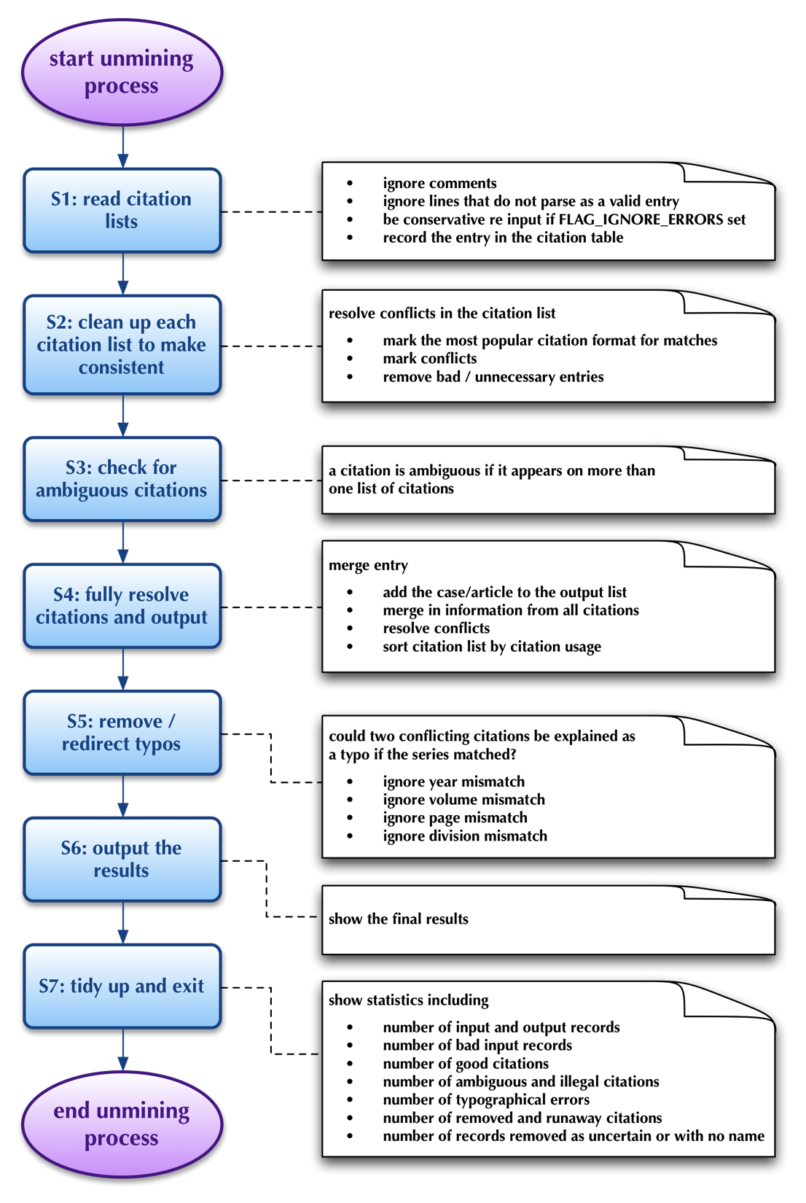
Unmining process

Slide 44
Handling ambiguity

Slide 45
XML citation database example

Slide 46
LawCite citator
LawCite contains 4.2M case / journal article citation entries
Free-access citator with global coverage
Automatically generated and maintained
Fully integrated with AustLII – ‘By Citation Frequency’
Markup tool

Slide 47
LawCite example

Slide 48
5. Replication & backup

Slide 49
6. Simultaneous searching in multiple languages
SINO was developed initially for English and has been extended to other western languages
extending SINO to handle UTF-8
SINO’s u16a representation
Any non-ASCII UTF-8 character (eg Chinese, Korean) can be converted into an alpha-numeric (flat) representation
Hexadecimal form – 0 to 9 and A to F
Resulting form may be confused with numeric words in western languages
‘春’ is ‘6625’ in hexadecimal form

Slide 50
SINO’s u16a representation (2)
The characters ‘u16a’ are added to any such representation to create a unique string
‘u16a’ is rare to non-existent in natural language
These u16a ‘shadow files’ are then used for SINO to search (as a proxy for the original)
text in the original language is presented to the user
Example: bankrupt* or insolven* or การล้มละลาย or kepailitan or pailit or 破產 or 破产 or Phá sản

Slide 51
Example: English, Thai, Chinese, Indonesian

Slide 52
7. Point-in-time legislation
ability to consider what a piece of legislation stated at some point in the past and to navigate legislation historically
multi-jurisdictional in nature
automated approach
variety of data formats – some are XML documents; others are just Word documents
quality of data varies between jurisdictions
challenge: uniform and consistent interface

Slide 53
Point-in-time legislation - Versions

Slide 54
Point-in-time legislation – compare versions

Slide 55
Example 2: Lower quality data

Slide 56
Compare versions

Slide 57
8. Subject-specific libraries
Issue: How can LIIs create subject-oriented resources economically?
AustLII’s method of creating subject-oriented ‘Libraries’ by semi-automated means
Include all relevant specialist databases
Editor develops search of remaining DBs for subject, and decides what percentage of results are sufficiently relevant
Concordance created of that % of results => virtual database for inclusion in Library.
Search re-run, with same % of results used for concordance, for automatic updates of virtual DB

Slide 58
Indigenous Law Library

Slide 59
Likely key future technologies
Using legal dictionaries to automate cross-language searching
Searching without users anticipating text occurrence
using citation patterns to find similar documents
using search logs to create ‘best’ search
Crowd-sourcing, suitable for an authoritative law site

Slide 60
Thank you – Questions?

